Slide 1
Safety organization
Safety organization can be defined as the structure and process by which groups of people (employees) are divided into sections or departments, each section or department is assigned specific safety function or duty.
Authority and responsibility of everybody is clearly defined and interrelationship between them is specified for the accomplishment of organizational safety goals.
A large unit may have safety department which may have groups of people for division of such safety function and responsibilities.
But in a small unit (majority) if such division is not possible and only a few persons are available for safety work, they will be assigned specific duty and other departmental heads (production, purchase, personnel etc.) will be explained their role and responsibility towards safety goals.
All supervisors shall be integrated with safety as part of their duty. ‘Safety is everybody’s duty’ will be explained to all with their safety duty given in writing or by displaying at their workplaces.

Slide 2
Need (Significance) of Safety Organization
Prevents workplace accidents and injuries.
Ensures compliance with safety laws and standards.
Protects employees, equipment, and property.
Reduces financial losses and production downtime.
Improves productivity, morale, and organizational reputation.
Promotes safety awareness through training and inspections.
Enhances emergency preparedness and continuous improvement.

Slide 3
Objectives of safety organization
To prevent accidents in future
To provide safe work environment
Safety consciousness
Integrate safety policies with job process
Compliance of rules as per factory act
Ensure and modify on identified risk
Training to ensure safety
Invite cooperation and suggestions from the employees
To take measures after accident

Slide 4
Functions & Duties of safety organization
Formulation and implementation of safety policies, rules, and procedures.
Regular safety inspections, audits, and site evaluations.
Accident and incident investigation, root cause analysis, and reporting.
Identification, assessment, and control of workplace hazards and risks.
Development and delivery of mandatory safety training and orientation programs.
Ensuring compliance with local, national, and industry safety regulations and laws.
Maintenance and management of emergency response and disaster mitigation plans.
Selection, distribution, and monitoring of Personal Protective Equipment (PPE).
Monitoring employee health programs and occupational medical screenings.
Collection, analysis, and tracking of safety data and performance statistics.

Slide 5

Safety organization

Slide 6
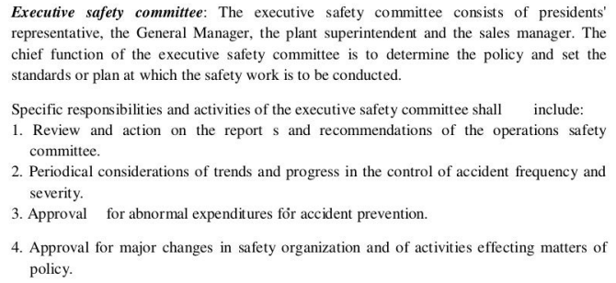

Slide 7
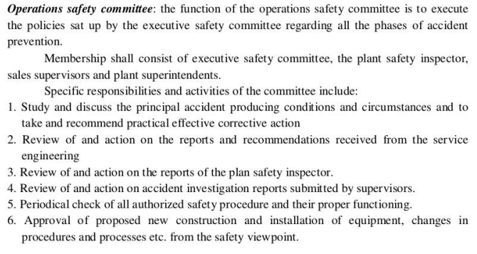

Slide 8
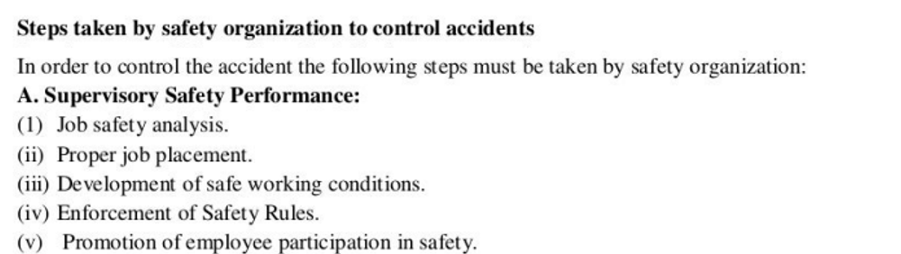

Slide 9
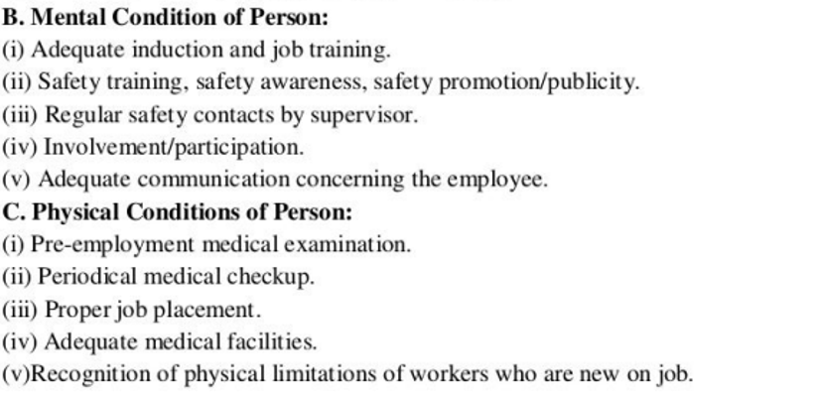

Slide 10
